Slide 1
Architecture Design Session (ADS)

Slide 2
Contents
What is an ADS?
When do you deliver ADS?
How do you determine whether an ADS has been successful?
How do you plan for success in an ADS?

Slide 3


What is an ADS?
An Architecture Design Session (ADS) is a one- to multi-day engagement driven by technical sales that maps technical solutions to customer opportunities.
Notes:
Before we discuss mastery of an Architecture Design Session, let’s first define what an ADS is.
There are alternatives to the collaborative problem-solving approach of an ADS – before committing to an ADS you should be sure an ADS is the best engagement option.
A product briefing or demonstration is better for information on services and offerings.
Hands-on labs or trainings are better for providing experience with services.

Slide 4
The goal for the customer, is to get a solution designed and deployed. Ultimately the ADS should result in a PoC or a pilot.
What are the
ADS outcomes?

Slide 5
Requirements for success
1. Preparation
You will need significant time for planning prior to the engagement and for collaboration during the engagement.
2. Delivery
You will identify the opportunity and current state, whiteboard and develop possible solutions for the future state, and propose an implementation plan.
3. Follow-up
An ADS is one effective way to land on a shared vision and scope.
Notes:
To successfully lead an ADS, you will need significant time for planning prior to the engagement and for collaboration during the engagement.
In the session, you will identify the opportunity and current state, whiteboard and develop possible solutions for the future state, and propose an implementation plan.
Delivering an ADS is one effective way to land on a shared vision and scope.

Slide 6
Example ADS activities including pre & post work
Before the ADS
Preliminary requirements clarification | 9:00 am - 9:30 am
Ideation & Baseline/Candidate Architecture Discussion | 9:30 am - 10:30 am
During the ADS
 | Day 1
Detailed discovery | 9:00 am - 12:00 pm
Envisioning | 1:00 pm - 5:00 pm
 | Day 2
Whiteboard Candidate Architecture(s) | 9:00 am - 12:00 pm
Identify and define POC and Pilot(s) | 1:00 pm – 4:00 pm
Document high level deliverables and next action steps | 4:00 pm – 5:00 pm
This work can be performed remotely.
After the ADS
Create architecture diagrams | *Varies by project
Review architecture diagrams with ADS team | 9:30 am - 10:30 am
The ADS should be performed in-person.
This work can be performed remotely.

Slide 7
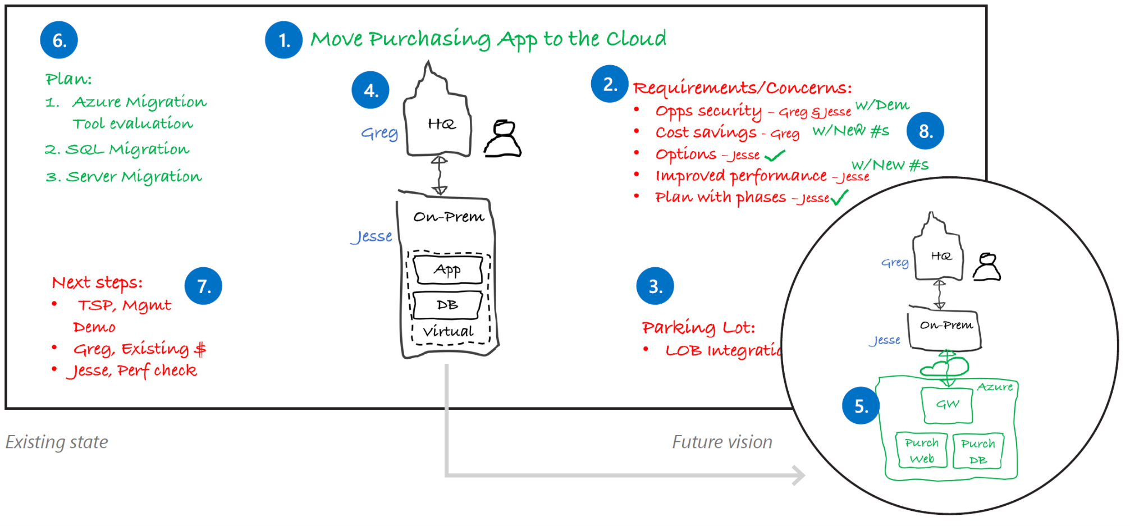
Proven practice whiteboard layout
Project Goal
Plan
Requirements
Future State
Next Steps
Current State
Parking Lot
Notes:
Whiteboards and Surface Hub support the type of collaboration you’ll need for a successful ADS.
Focus on your stakeholders, use the whiteboard as a tool for recording ideas, and get approval at each step before moving forward.
1. Project goal
Write down the project goal to help focus everyone to the desired outcomes.
2. Requirements and concerns
Begin with the items you’ve listed from the pre-call. Make sure that everyone gets a chance to be heard. Write down names next to each person’s requirements or concerns.
3. Parking lot
Acknowledge out-of-scope items. Help people set these concerns aside for later and focus back on the topic at hand.
4. Current state
Diagram the current state and ownership in black. The customer may help diagram this on the whiteboard. Be careful with technical depth. Focus on the system details that affect the ADS outcomes.
5. Future vision
Capture a high-level view of what the customer really wants in green before diving into technologies. Help customers envision the potential opportunities with Microsoft technologies.
6. Implementation plan
Break the plan into clear steps so the customer can track the project schedule and budget flexibility.
7. Next steps
Assign immediate action items during the meeting.
8. Wrap-up
Verify with all stakeholders that their requirements and concerns have been sufficiently addressed with the solution and plan. Close with agreement on the next steps.

Slide 8

Whiteboarding Tips
Start with a proven practice whiteboard layout.
Use standard icons from the Microsoft Cloud & Enterprise symbol set.
Memorize your frequently used icons so you can sketch them quickly and be consistent.
Use the design to confirm your understanding with the customer.
Refine the whiteboard “sketch” in Visio or PowerPoint.
Notes:
During the ADS, you and your customer planned a high-level architecture and conceptual design for a solution that addresses their organization’s business goals and technical requirements.

Slide 9
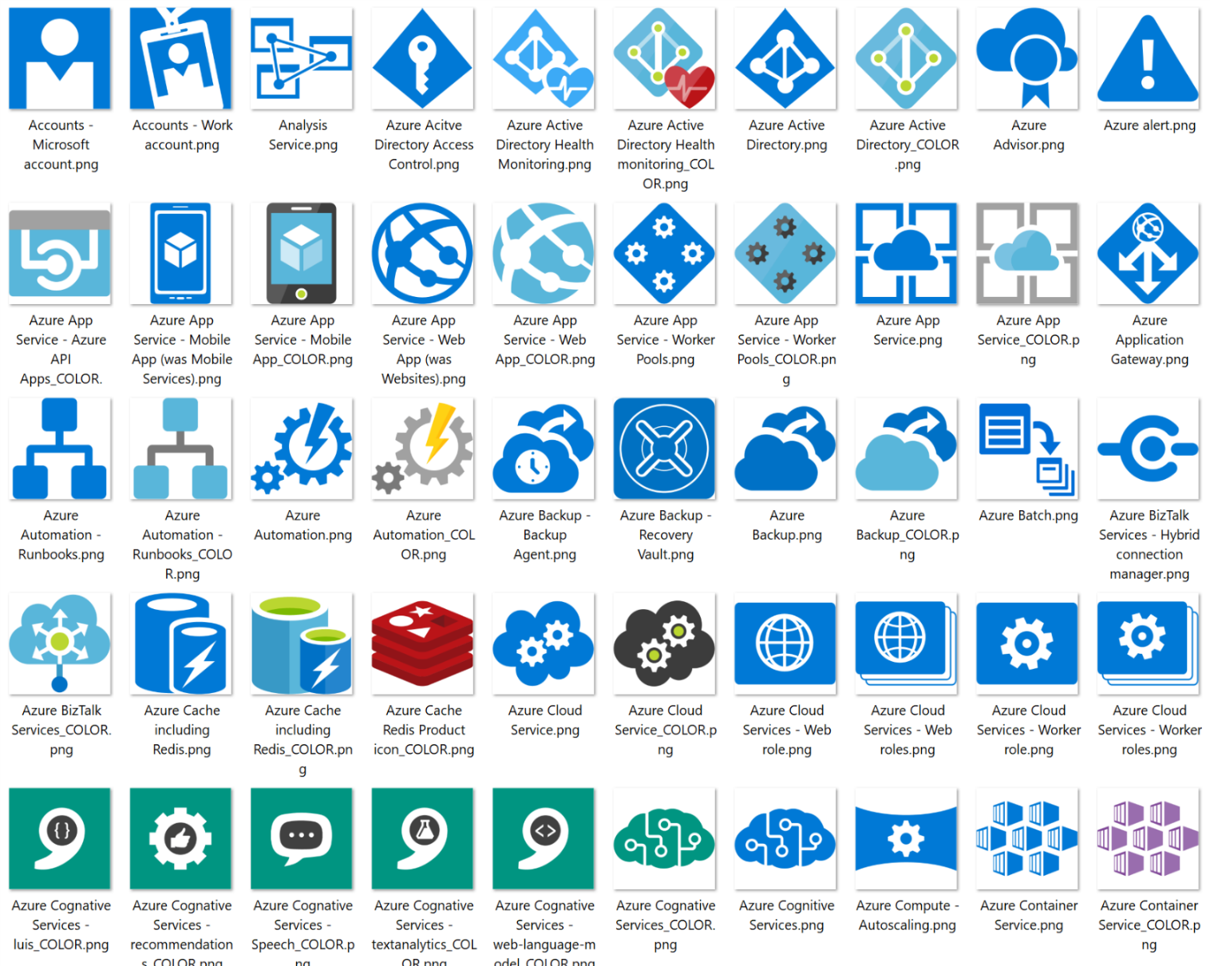
Use standard icons for Azure services
All icons available under the Symbols\CNE_Cloud folder.
Files types in package
Visio Stencil (.vss)
PNG file
SVG file
Download the Microsoft Azure, Cloud and Enterprise Symbol/Icon Set
http://aka.ms/azurevisio
Notes:
Microsoft has made available icon libraries for PowerPoint (as PNG files) and Visio that simplify creating great diagrams using standardized icons for Azure services.

Slide 10
ADS follow-up
Distribute the meeting artifacts to the ADS participants.
Include:
Photos of the board(s)
Key decisions made
Document:
Requirements and concerns
Implementation plan
Next steps and action items
A formal illustration of the current state and proposed solution in PowerPoint or Visio

Slide 11
How to scale your ADS
Assess the required knowledge areas
Get a SME team together
Manage technical and organizational responsibilities
Plan for additional collaboration review/design steps in the pre, delivery and post phases
Eliminate redundancies
Produce a cohesive solution
Be the one voice of your organization to your customer

Slide 12
PoC and Pilot

Slide 13
Decision Tree – PoC or Pilot?
When choosing between implementing a PoC or a pilot for a given scope, consider the following questions to help you make your decision:
Will proving the scope out earlier risk the overall project?
yes
no
Is there uncertainty about the recommended technology/architecture?
Start
yes
no
Does it need to release into production?
Is the technology/architecture unfamiliar to the customer?
no
yes
yes
no
Build a Pilot
Build a PoC
Build neither PoC or Pilot, deliver as part of solution
Notes:
Your ADS may involve delivering technical artifacts in addition to documentation and a detailed plan. Building a pilot that runs in your customer’s Azure subscription is most likely your goal. Sometimes you need to proof-out to de-risk certain aspects of the design by creating a POC. There are some benefits to doing this:
Builds confidence
Creates trust
Ensures successful pilot
As a technical seller, you'll tend to prefer pilots because they get the meter going in the customer's subscription. However, does not diminish the value of proofs of technology, as they may be created en route to the pilot.
A proof of concept is meant to overcome customer objections by demonstrating the solution will solve the problem for which it is designed. Treat a PoC as a continuous learning and improvement process for the solution. A rapid execution tempo of the PoC helps validate the customer’s requirements, while giving them confidence in your ability to deliver on your promises. A successful PoC can serve as evidence that your practice can use for future engagements with your customer or new ones. In fact, many times the output of a PoC can be added to your practice’s intellectual property list for demonstrations, or used to accelerate future solutions.

Slide 14
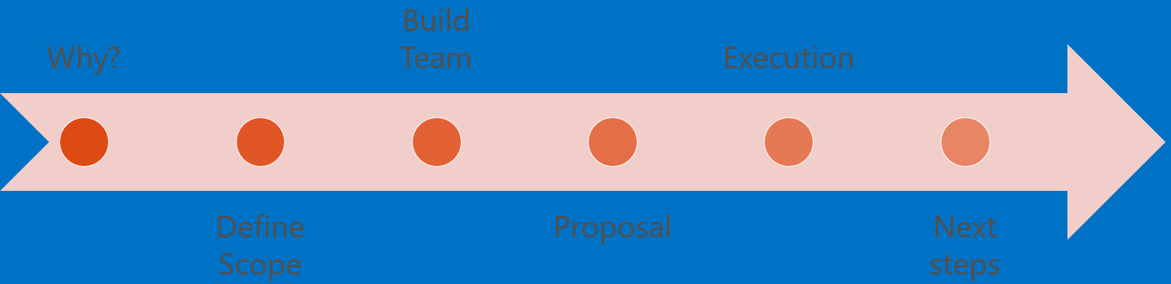
Deliver a Proof of Concept AI Project
AI projects include significant risks – for example, the data required may not be available or the problem may not lend itself to accurate prediction. Reduce the risk of overpromising on AI capabilities by conducting a focused proof of concept that enables you to de-risk the riskiest elements of the larger AI solution, build trust with the customer and deliver working AI solutions in a shorter timeline.
Proof of Concept High Level Flow

Slide 15
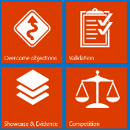
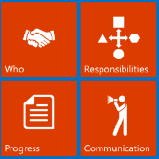
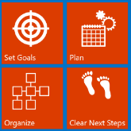
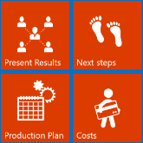
 | Why Perform a Proof of Concept for AI?
Substantiate that an AI solution can actually deliver on the vision capture during the envisioning session. Avoid skepticism on the part of client about the capabilities that can be realized and detect situations over-promising on the capabilities of AI before any significant investment occurs. Leverage the PoC as an example for future engagements with the same customer or with new customers for demonstrations, to show value, or to accelerate future solutions.
 | PoC Execution
Identify the technical resources needed for the PoC. This will include the technical implementation team (including developers and data scientists), as well as project management for tracking the progress of the engagement. Focus on delivering the PoC of the envisioned AI solution within the defined scope. For example, attempt the solution first with pre-built AI, before going down the path of building out the custom AI. Avoiding the temptation to start with the more complex solution (such as building a custom AI) is a good strategy for minimizing the scope required of a PoC.
 | Define Scope
Conduct an envisioning session or an architecture design session (ADS) to align business and technical requirements and set clear goals. Define a clear and concrete scope for the PoC that include: AI workloads and features to demonstrate. Identify and prioritize the aspects that are high risk. Identify the data that will be used to train any underlying AI models. Determine what you want to prove and which objections need to be overcome. Clearly demarcate responsibilities and set up organization. Set up subscriptions, define payment, and perform cost estimates of the PoC. Agree on the next step if success criteria are met.
 | Next Step
At the end of the PoC, report on the overall status of the PoC, and identify the issues, pros and cons, and value prop of moving forward with a real implementation. Calculate the expected production costs over time, and put a plan into place to deploy the PoC into production while ensuring that the PoC is designed for production usage. For example, upon completing your AI PoC you might report on the success or failure of utilizing a pre-built AI, the quality and predictive strength of the customer supplied data used for training a custom AI, or the feasibility of realizing the customer’s vision.

Slide 16

Examples of an AI PoC
Example Vision | Example PoC
We want to increase sales by getting shoppers to commit to a purchase they have been mulling over. If we can detect this behavior we’d like to provide just enough of a discount to encourage the purchase | Focus on the core aspect of the scenario (predicting a discount that leads to a purchase) and demonstrate the PoC in a notebook or other approach that minimizes efforts in building UI. The PoC scope would include analyzing the client’s purchase history and building a custom AI identifying the right predictive algorithm to suggest a discount within a bounded range that has a high probability of sale. By conducting this PoC you will have verified if the customer has the necessary data to make such predictions.
We would like to add chat bot capabilities to our solution that could address commonly asked questions before needing to speak to a live operator. | Utilize a bare-bones chat bot UI and provide the customer an initial understanding of the experience by applying pre-built AI to help in turning assets like frequently asked questions into conversational AI. Avoid getting into custom AI in this PoC. This will help the customer get a sense for the type of interaction that is possible and how the computer to human handoff might work, without significant investment in developing a custom AI.
We want to monitor how happy people are during their chat-based interaction with our agents in real time. We are concerned that we can only do this after the fact, at which point it is too late. | Utilize pre-built AI to apply sentiment analysis to historical chat message flowing through a minimalist chat environment, which demonstrates various alerts appearing around the chat messages when sentiment thresholds are crossed. Focus on the speed of processing and the accuracy of the sentiment established. By utilizing pre-built AI first in the PoC you can identify if the vocabulary and patterns of speech are suitably understood by generic sentiment analysis before investing effort in building custom chat histories manually tagged with sentiment and used to train a custom AI.

Slide 17
Deliver a Pilot for an AI Project
Consider offering your services as a pilot project to your prospects. With a pilot project, the customer receives two important values. First, they get to better understand how the project goals will be successful, and second, they have a production-grade starting point for their larger efforts.
A typical pilot undergoes the following phases:
Define scopetypically occurs during an architecture design session (ADS)
Execute implementation create, test, refine, repeat
Conclude
post-mortem, validation, path to production plan
typically occurs during an architecture design session (ADS)
create, test, refine, repeat

Slide 18
Checklists

Slide 19
Complete the pre-ADS checklist
A successful architecture design session relies on preparation. After the ideation, or opportunity definition session, perform the following checklist of items to prepare for the ADS:
Schedule a time: Typically 1-2 days or a design session
Schedule a location: Ensure you have whiteboards and a projector
Schedule resources: Experts from your team, and a cross-cutting panel of technical and business stakeholders from the customer
Build an agenda: Establish milestone goals in advance so that the ADS doesn’t get consumed discussing a single topic
Prepare preliminary documentation and architectural diagrams, such as baseline architecture. Even if you only have the basic building blocks, it’s good to come prepared with something you can modify during or after the session.

Slide 20

Discovery Checklist
Allow ~3 hours
Work with your group to review and whiteboard customer requirements, using prepared notes and diagrams from the ideation session as a guide.
Be sure to do the following:
Ensure customer background & business strategy is understood.
Clarify the project background and its drivers/aims.
Cover the technology landscape: Do they require a hybrid solution or 100% cloud, what is the current technology competency of the team if they will be maintaining the solution, has the customer proposed technologies they’d like to use.
Go over usage scenarios for the solution, from the perspective of their internal and external users.
Take down all upfront functional and non-functional requirements.

Slide 21
Planning Checklist
Allow ~8 hours
Work with your group to establish a plan of action and parameters of deliverables, required resources, milestones, and deciding on POC or pilot opportunities and requirements.
Be sure to do the following:
Establish proof points
Identify exclusions, risks, and issues (refine solution functionality)
List project pre-requisites (legal, funding, technical, etc.)
List required resources
Notate long-term project plans (continued maintenance, training, handover to customer’s technical staff)
Establish parameters of communication (primary proof-testing, preferred means of communication, frequency of meetings, whether conducted in person or virtually, and how often)
Identify candidates for technology or design POC/prototype
Identify an opportunity for a pilot
Consider if POC or pilot is appropriate as the next step
Establish solution deliverables, including for POC or pilot if applicable

Slide 22
After the ADS Checklist
During the ADS, you and your customer planned a high-level architecture and conceptual design for a solution that addresses their organization’s business goals and technical requirements. After the ADS, you’ll deliver the following:
Summary of the ADS engagement with customer
A proposed timeline of solution deliverables, including deliverables for POC or pilot if applicable
Final architecture diagrams for customer to sign off
Special areas of concern, such as security, compliance, and compatibility
Proposed Microsoft and open source/3rd party technologies to be used for the solution, listing any trade-offs amongst differing technology options
Complete deployment plan with specific examples, covering development, staging, and production targets where applicable
Showcase of the capabilities of your solution to deliver business value on premises and/or the cloud

Slide 23
AI Pilot Project Checklists
DURING THE PILOT CHECKLIST
The following checklist provides the core tasks you should complete when conducting a pilot. Go over established business and technical requirements from the detailed requirements gathering session (e.g., architecture design session) Determine which features will be included in the pilot that provide a minimum viable product Conduct a full-fledged design, mapping requirements to workloads and features of the pilot Establish team responsibilities and organization Perform cost estimates (e.g., for Azure services used like Cognitive Services, Machine Learning, etc.) Outline next steps after the success criteria is met
AFTER THE PILOT CHECKLIST
The next step is to propose the move to production and provide a cost estimate and delivery schedule to the customer. You should perform the following in concluding a pilot: Learn to identify the end of the pilot; when the proposed features are functional and validated, and when the business transformation begins Conduct a post-mortem of the pilot, talking to users, business managers, developers, and development managers. Evaluate lessons learned and refine feature list to include any features excluded from the pilot Upon agreeing to move to production phase, establish cost and delivery schedule based on established plan to transform to v1 product

